Slide 1
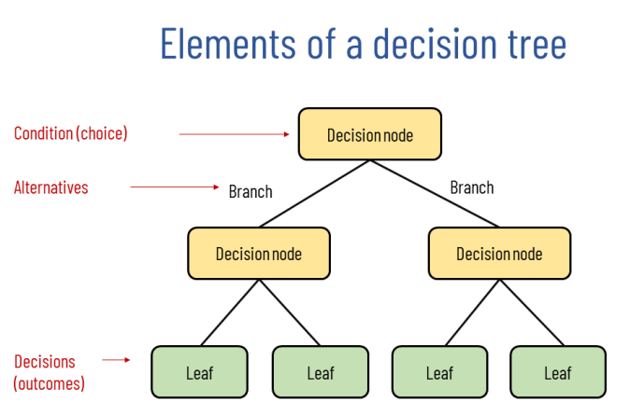
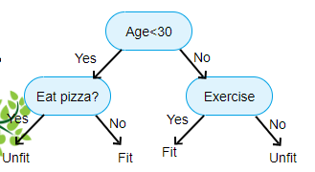
Decision trees can take as input continuous, categorical and mix of continuous and categorical variables
They can be used for both classification and regression
They can be also used for clustering. Each leaf is a cluster
Video with great explanation of this model: https://www.youtube.com/watch?v=_L39rN6gz7Y
root node

Slide 2
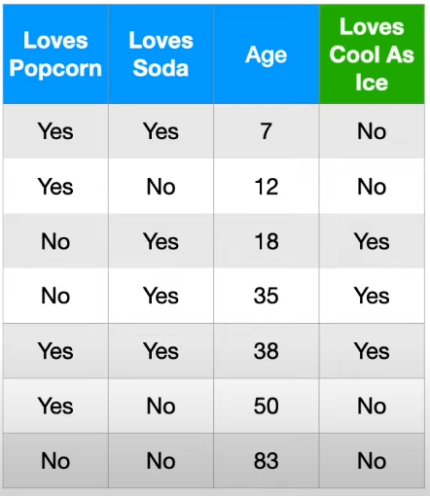
As example we will consider this dataset and this decission tree. We want to predict values in the ‘loves cool as ice’ column
dataset
loves soda?
node 1
true
false
node 3
node 2
dataset1
age < 15?
dataset2
true
false
dataset3
dataset3
leaf 2
leaf 1

Slide 3
How a decision tree works
In each node we divide a dataset into two datasets by asking a question.
For example in the tree from the previous slide, in the first, root node we divide our dataset into two datasets: dataset 1 and dataset 2 based on values in the column ‘loves soda’. The dataset 1 contains people who love soda and the dataset 2 containes the ones who don’t.
Then we divide a dataset1 where people loves soda into another two datasets, one where people are younger than 15 and older. So each node corresponds to some dataset and it is dividing that dataset into two seperate subsets of that dataset.

Slide 4
How to build a decision tree
In order to decide what question will be asked in the first, root node we calculate a gini impurity for each column of our dataset. This value tells us how good is this question to makes predictions. In our case the first question is if a person loves soda and it splits our dataset into dataset 1 (people who loves sode) and dataset 2 (peoplo who don’t love soda).
In order to decide what question will be asked in the next node, if answer for the previous question was positive we do the same as in the previous step. This time we don’t take into account the column ‘loves soda’ which was already selected for the previous question and we are not splitting our original dataset but dataset 1.
We continue creating next nodes until a gini impurity for a node is 0, until we reach a maximum number of leaves or when we have too little data in a leaf to split it futher. We need to decide what is a maximum number of leaves and minimum number of data in each leaf.

Slide 5
Gini impurity interpretation
Gini impurity measures diversity of dataset. When we select randomly an element from a dataset, it tells us how sure we can be about which element we select. For example if we have a group of 10 people and 9 of them are men, when we select randomly 1 human we can be pretty sure it is a men so gini impurity is small, and if in that group there is 5 men and 5 women then we are less sure about who we will select so gini impurity is big.

Slide 6
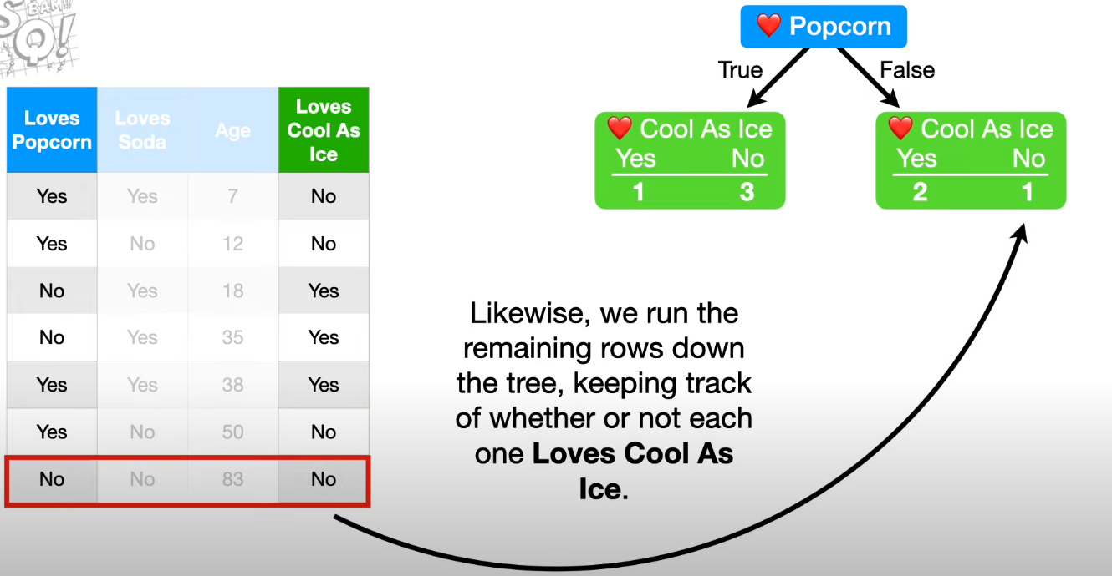
How to calculate a gini impurity
As an example we will calculate a gini impurity for the below dataset for the column ‘loves popcorn’. We want to predict values in the ‘loves cool as ice’ column. We divide our dataset into 2 subsets, one where people loves popcorn and one where they don’t. For each subset we check number of people who loves cool as ice and calculate a gini impurity.

Slide 7
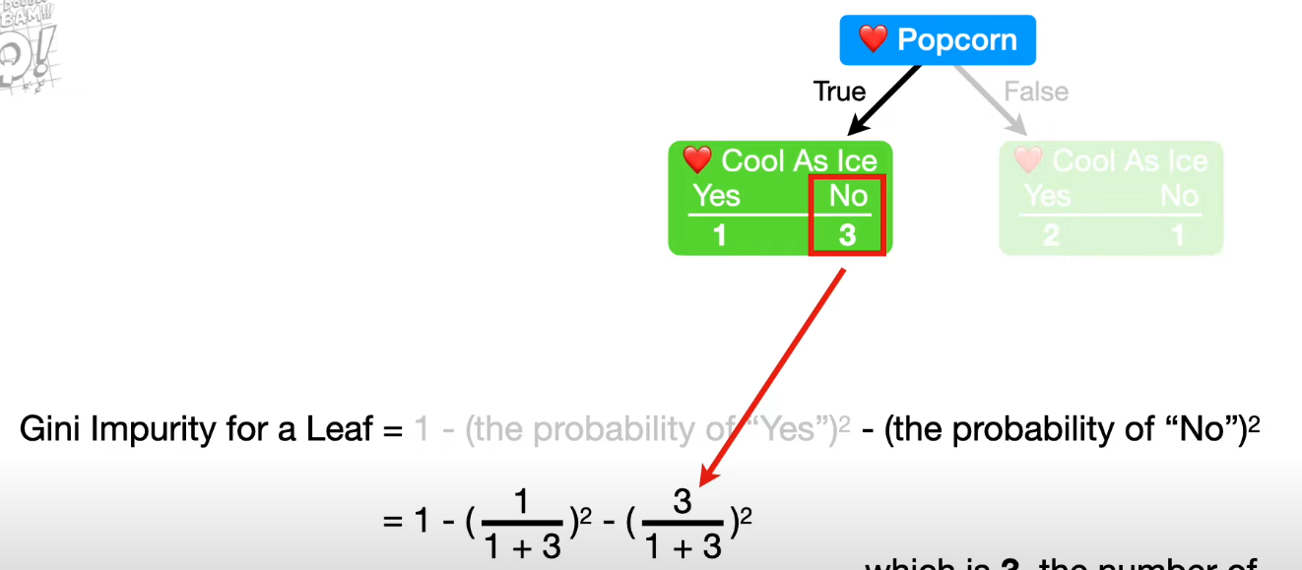
This is how we calculate a gini impurity for one leaf (subset):

Slide 8
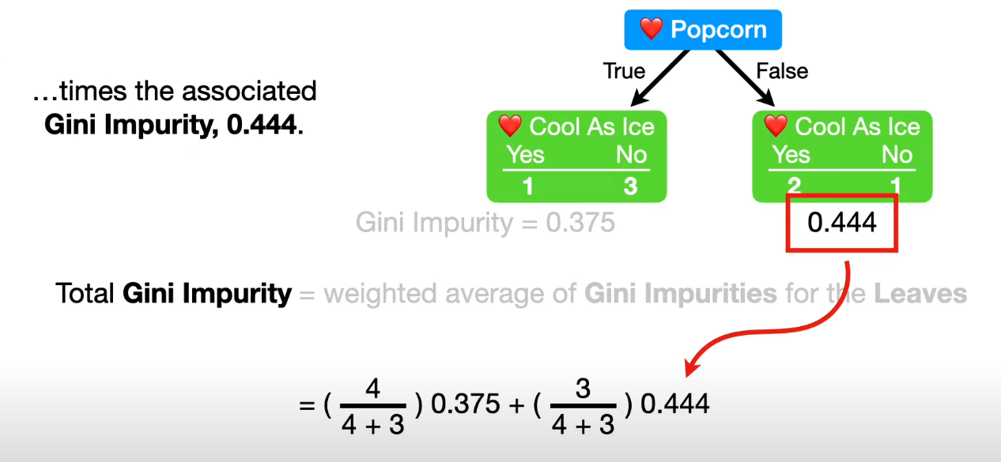
And this is how we calculate a gini impurity for a column ‘loves popcorn’:

Slide 9
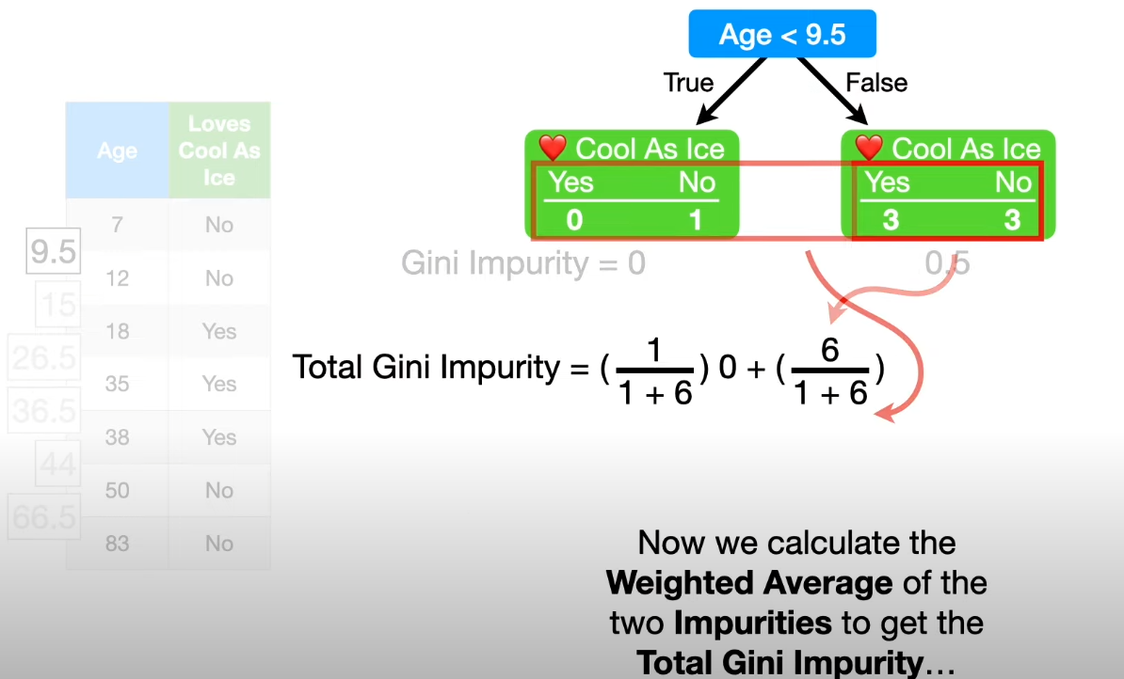
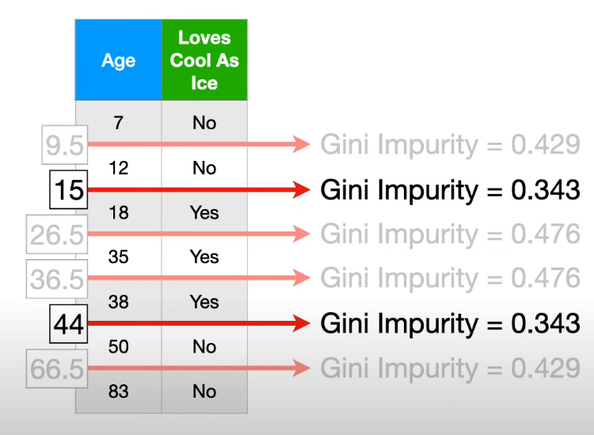
When our column has a continuous values, then we sort our column and take averages between rows and we calculate a gini impurity for each of those values. We choose this value for which a gini impurity is the lowest.

Slide 10
How to make predictions
When we have a new data sample we check to which leaf it belongs. For example if we have a sample where ‘loves popcorn’ = no, ‘loves soda’ = yes and ‘age’ = 15 then this sample will go to the leaf with dataset 3. Then we assign to this sample a class which is the most popular in this leaf.
If one variable has more than 2 categories, for example if in the column ‘loves soda’ we have values ‘yes’, ‘no’ and ‘I don’t know’ then in a node we can ask 3 possible questions about that column: ‘if loves soda = yes?’, ‘if loves soda = no?’ and ‘if loves soda = I don’t know?’.

Slide 11
How to build a regression tree
If we want to build a decision tree for predicting a value of a continuous variable then we again ask questions in each node to split a dataset into two seperate subsets. Then for each of those subsets we calculate a residuals instead of a gini impurity to check how good is that question for making predictions.

Slide 12
How to make predictions with a regression tree
In order to make predictions for a data sample we check to which leaf this sample belongs just like in a classification tree and we calculate an average value in that leaf dataset. That is our prediction.

Slide 13
Min_impurity_decrease argument for sklearn decission trees
Useful link: https://towardsdatascience.com/hyperparameters-of-decision-trees-explained-with-visualizations-1a6ef2f67edf
Trees does a split if that split causes decrease of impurity bigger then that value. The bigger that value is the less if probability of overfitting but model might be less accurate.

